Slide 1
ONLINE PLANT STORE
By
Viswanathan M

Slide 2


Agenda
A
Introduction
Existing Solution
Proposed Solution
Software Requirements
Frontend and Backend
Modules and Screenshots

Slide 3
Introduction
In today's digital age, e-commerce has transformed the way people shop for various products, including plants and gardening essentials. The Plant Online Shop project aims to create a user-friendly online platform where customers can browse, select, and purchase a wide range of plants, gardening tools, and related accessories conveniently from their homes.

Slide 4
Existing Solution
The current system of a plant online shop involves manual processes for handling orders, inventory, and customer interactions.
Orders are placed through phone calls, emails, or in-person visits, limiting the shop's customer base to local areas. Inventory management relies on basic spreadsheets or manual tracking methods, which can be inefficient.
Payments are collected in-person with cash or card upon delivery. Marketing is primarily local, and communication with customers is through direct means.
There is a lack of online presence and data analysis. Transitioning to an online shop would mean implementing a digital platform for online browsing, ordering, and payment, which would expand the customer reach, improve efficiency, and enhance overall customer experience.

Slide 5
Proposed Solution
The online plant shop system will allow customers to easily browse and purchase plants and related products online.
Customers can create accounts, search for plants by category or name, view detailed plant information, add items to a shopping cart, and securely checkout using integrated payment options.
Administrators will have tools to manage products, orders, users, and inventory through a user-friendly dashboard. The system will use modern technologies for both frontend (user interface) and backend (server-side logic), ensuring a responsive and reliable online shopping experience.
Optional features like reviews, wishlists, and email notifications will enhance user engagement.
The development process will involve planning, implementation, testing, and deployment to create a robust and efficient online plant shopping platform.

Slide 6
Software Requirements
The software required are
Web browser-Google Chrome
ReactJS, CSS, Javascript, ExpressJS
VS Code - IDE
MongoDB Atlas

Slide 7
Modules
The Modules are
Registration Page
Product Adding Page
Cart Page
Payment Page

Slide 8
Registration Page
In an Online Plant Store, the login module plays a critical role in ensuring secure and streamlined access for customers, administrators, and other stakeholders.
The login module is designed to authenticate customers, administrators, and other authorized personnel, allowing them access to the store's features based on their roles.
This module ensures that only registered and verified individuals can interact with the system, maintaining security and preventing unauthorized access.The login module can be accessed after registering an account on the site.

Slide 9
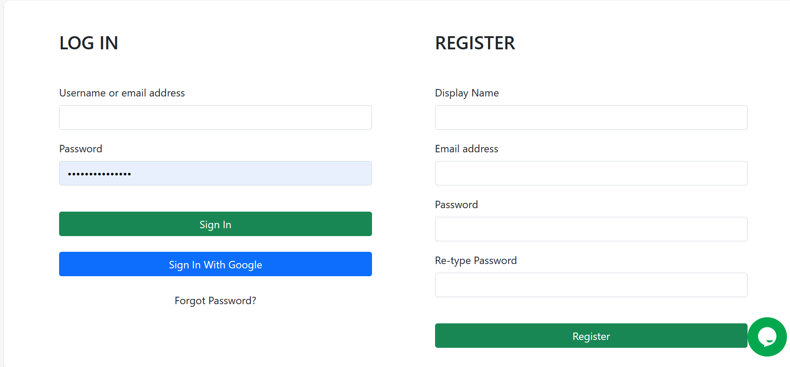
Registration Page

Slide 10
Product Adding Page
Product Listings: Display a variety of plants with images, descriptions, prices, and available quantities.
Filters and Search: Allow customers to filter plants by categories, such as indoor, outdoor, flowering, succulents, etc., and search for specific plants.
Product Details: Provide detailed information about each plant, including care instructions, size, and customer reviews.

Slide 11
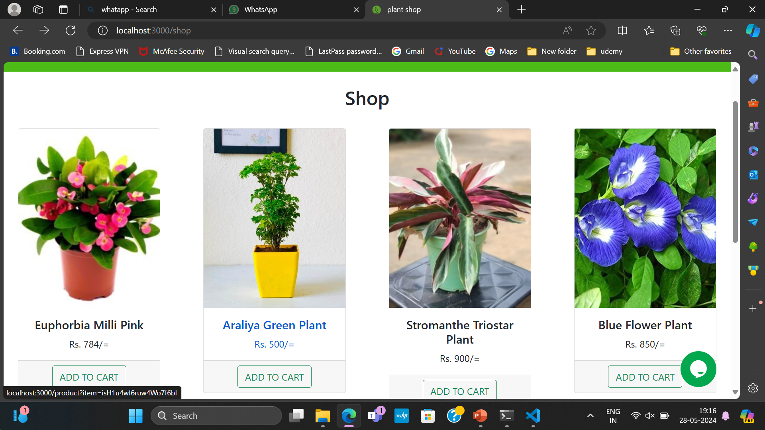
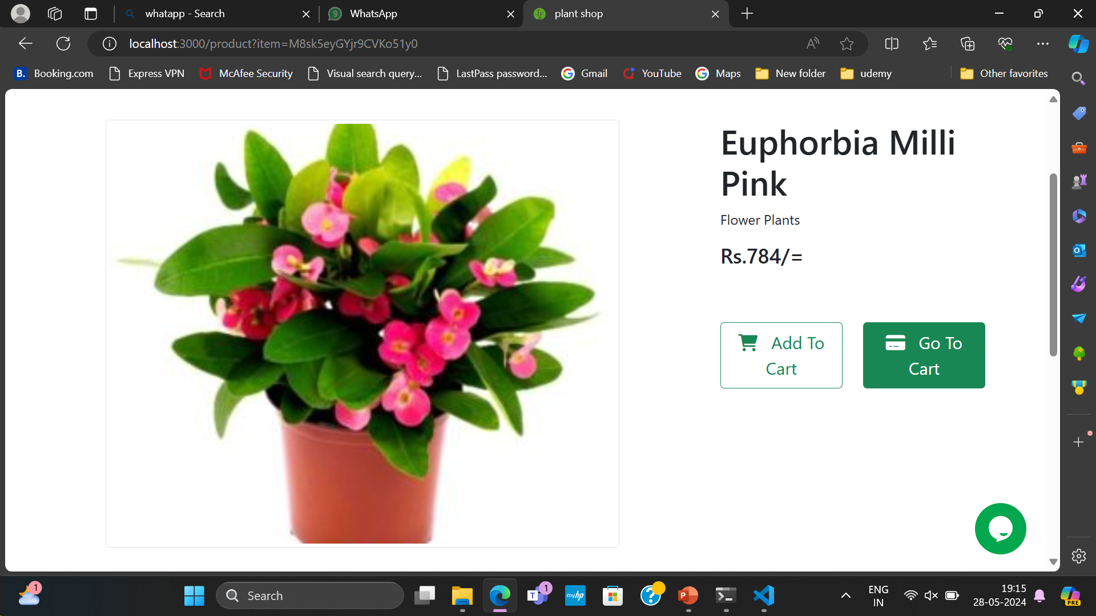
Product Adding Page

Slide 12
Cart Page
Cart PageCart Summary: Show a list of selected plants with quantities, prices, and subtotal.
Edit Cart: Allow customers to update quantities, remove items, or save items for later.
Estimated Total: Display the total cost, including any applicable taxes and shipping fees.

Slide 13
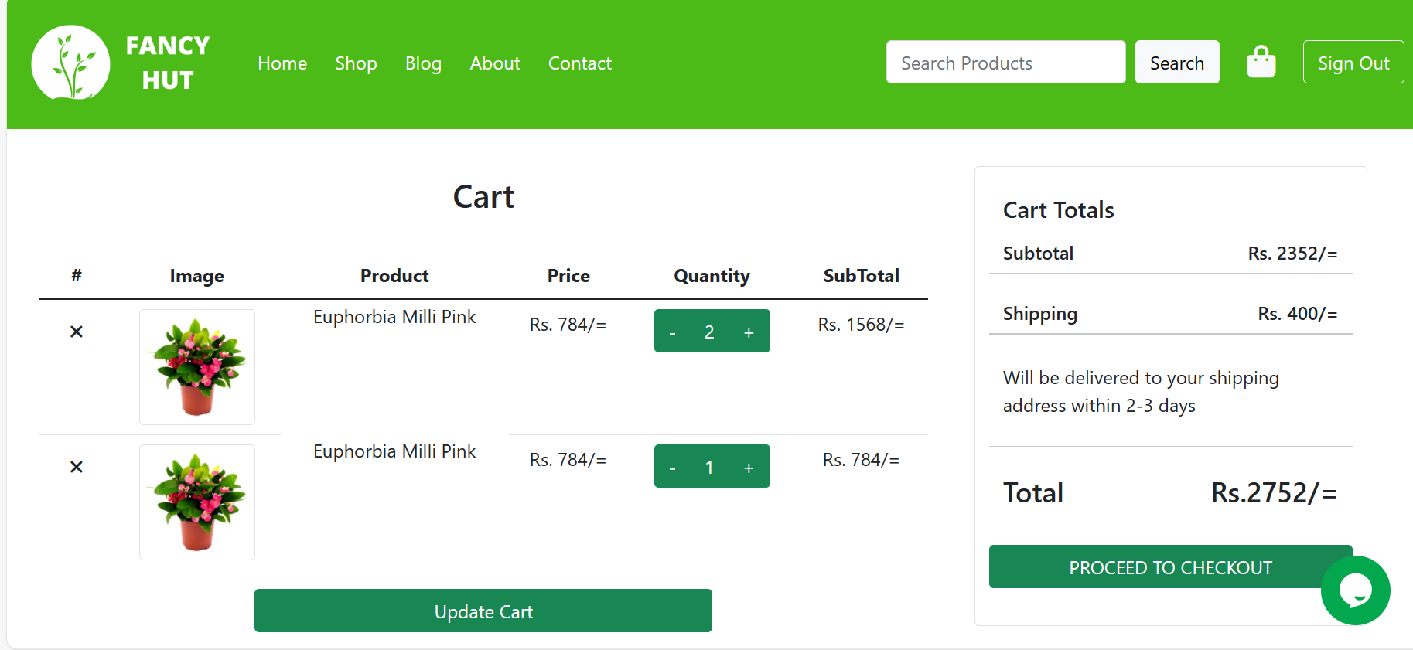
Cart Page

Slide 14
Payment Page
The payment module for the bicycle rental system will allow users to securely pay for their bicycle rentals using either PayPal or Stripe. This module will handle various payment-related tasks, including:
User authentication and authorization
Payment processing
Transaction management
Secure data transmission
Payment Gateway: Integrates with secure payment gateways to accept various payment methods, including credit/debit cards, digital wallets, and bank transfers.
Payment Status: Tracks the status of payments and provides users with receipts and payment confirmations.
View Bookings: After payment, allows users to view their upcoming and past bookings, including details and status.

Slide 15
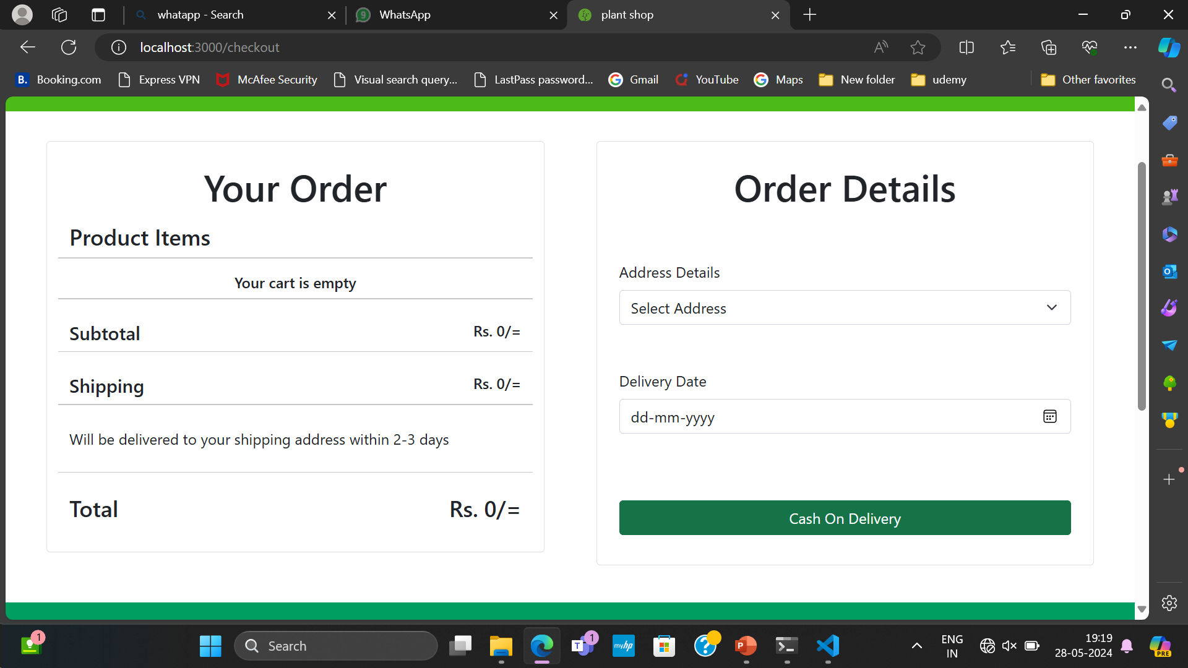
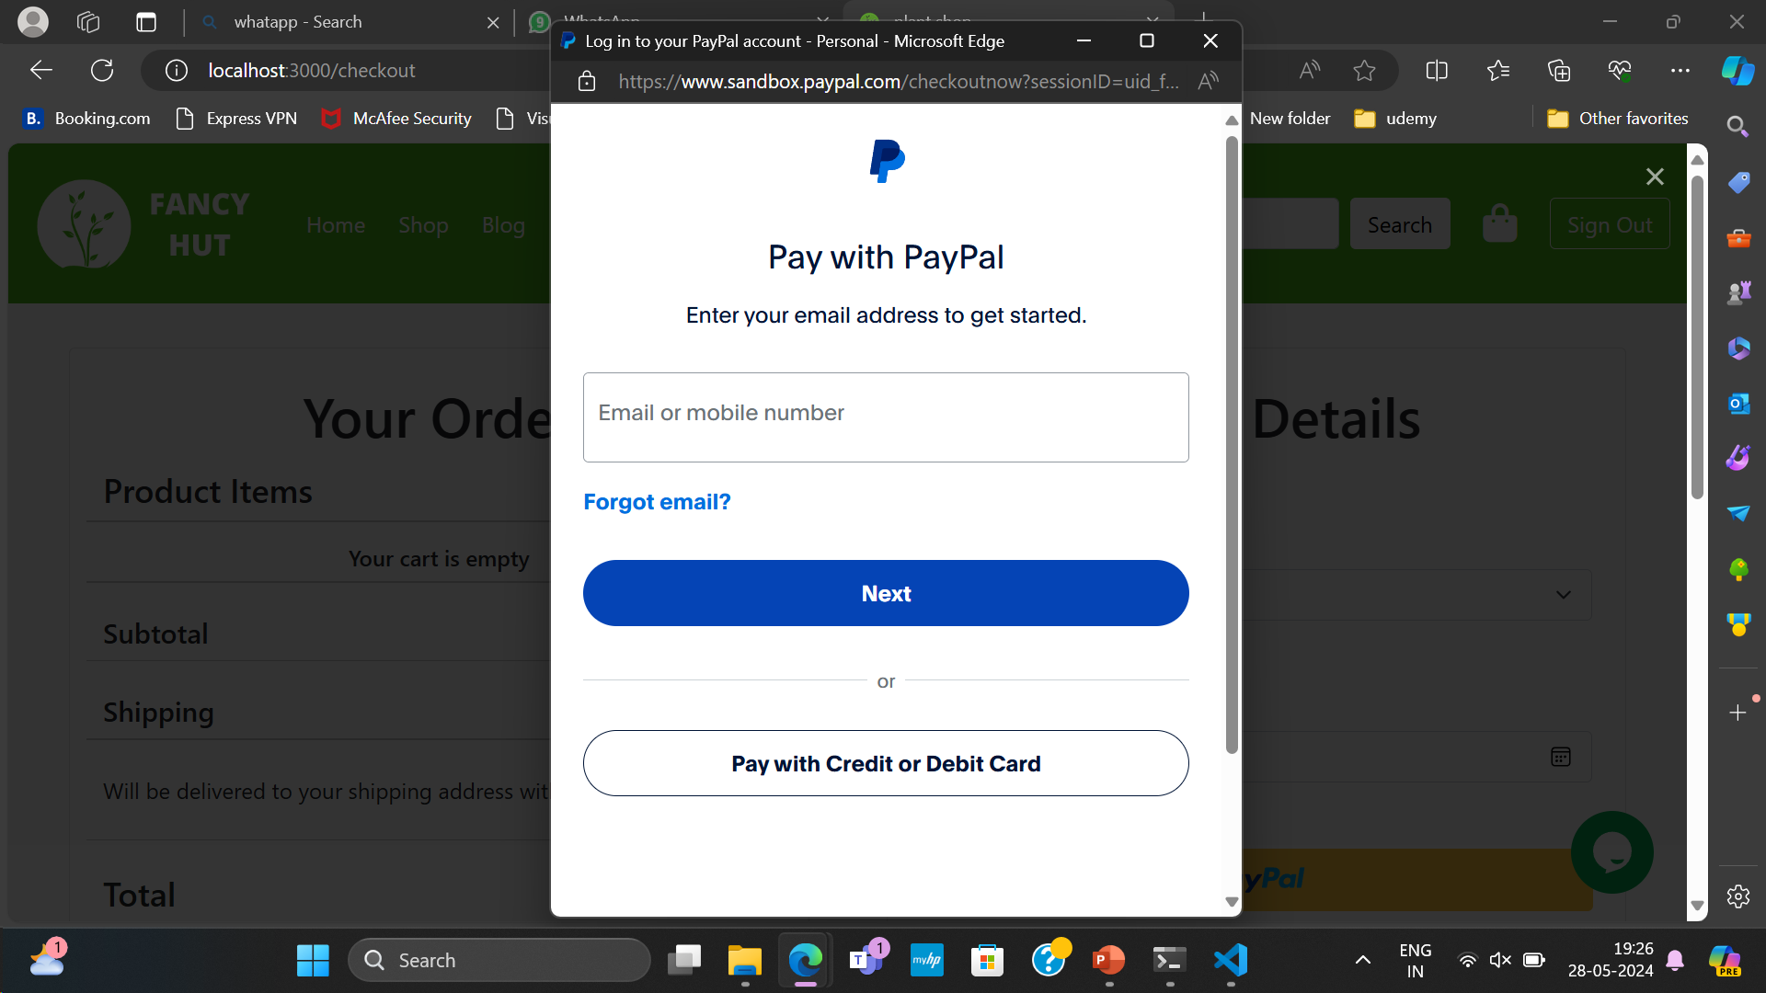
Payment Page

Slide 16
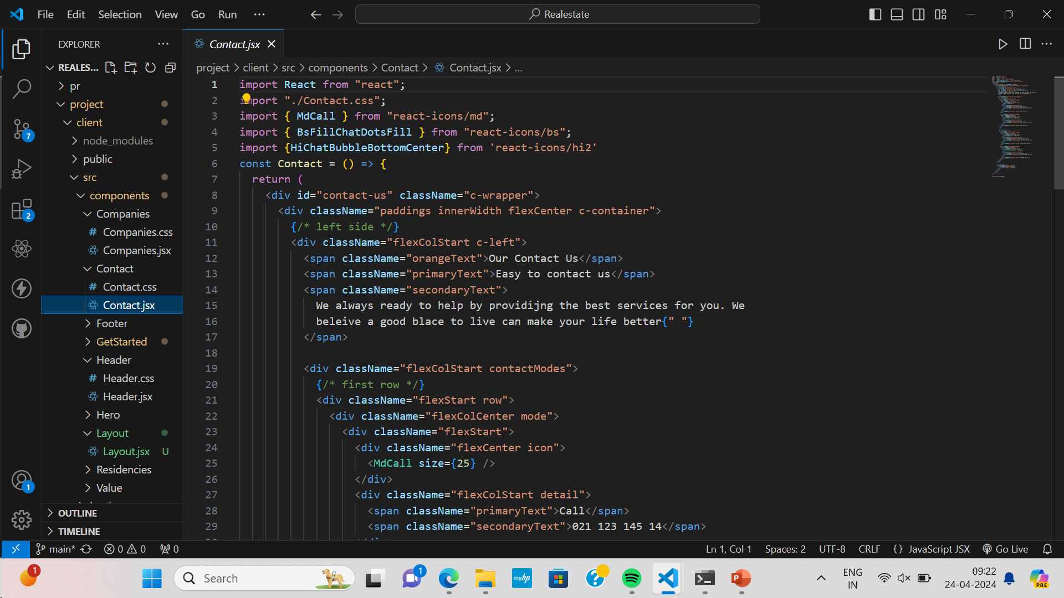
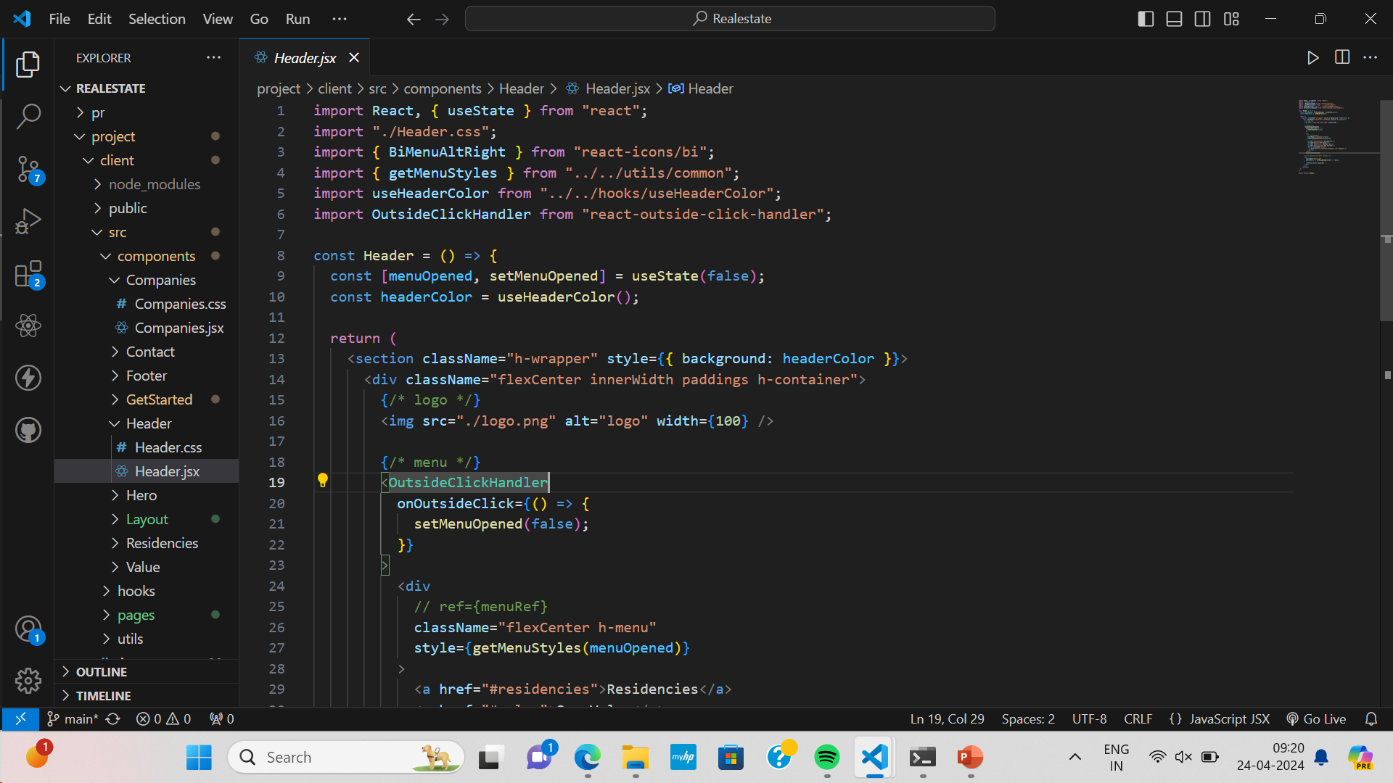
Frontend Code Screenshots

Slide 17
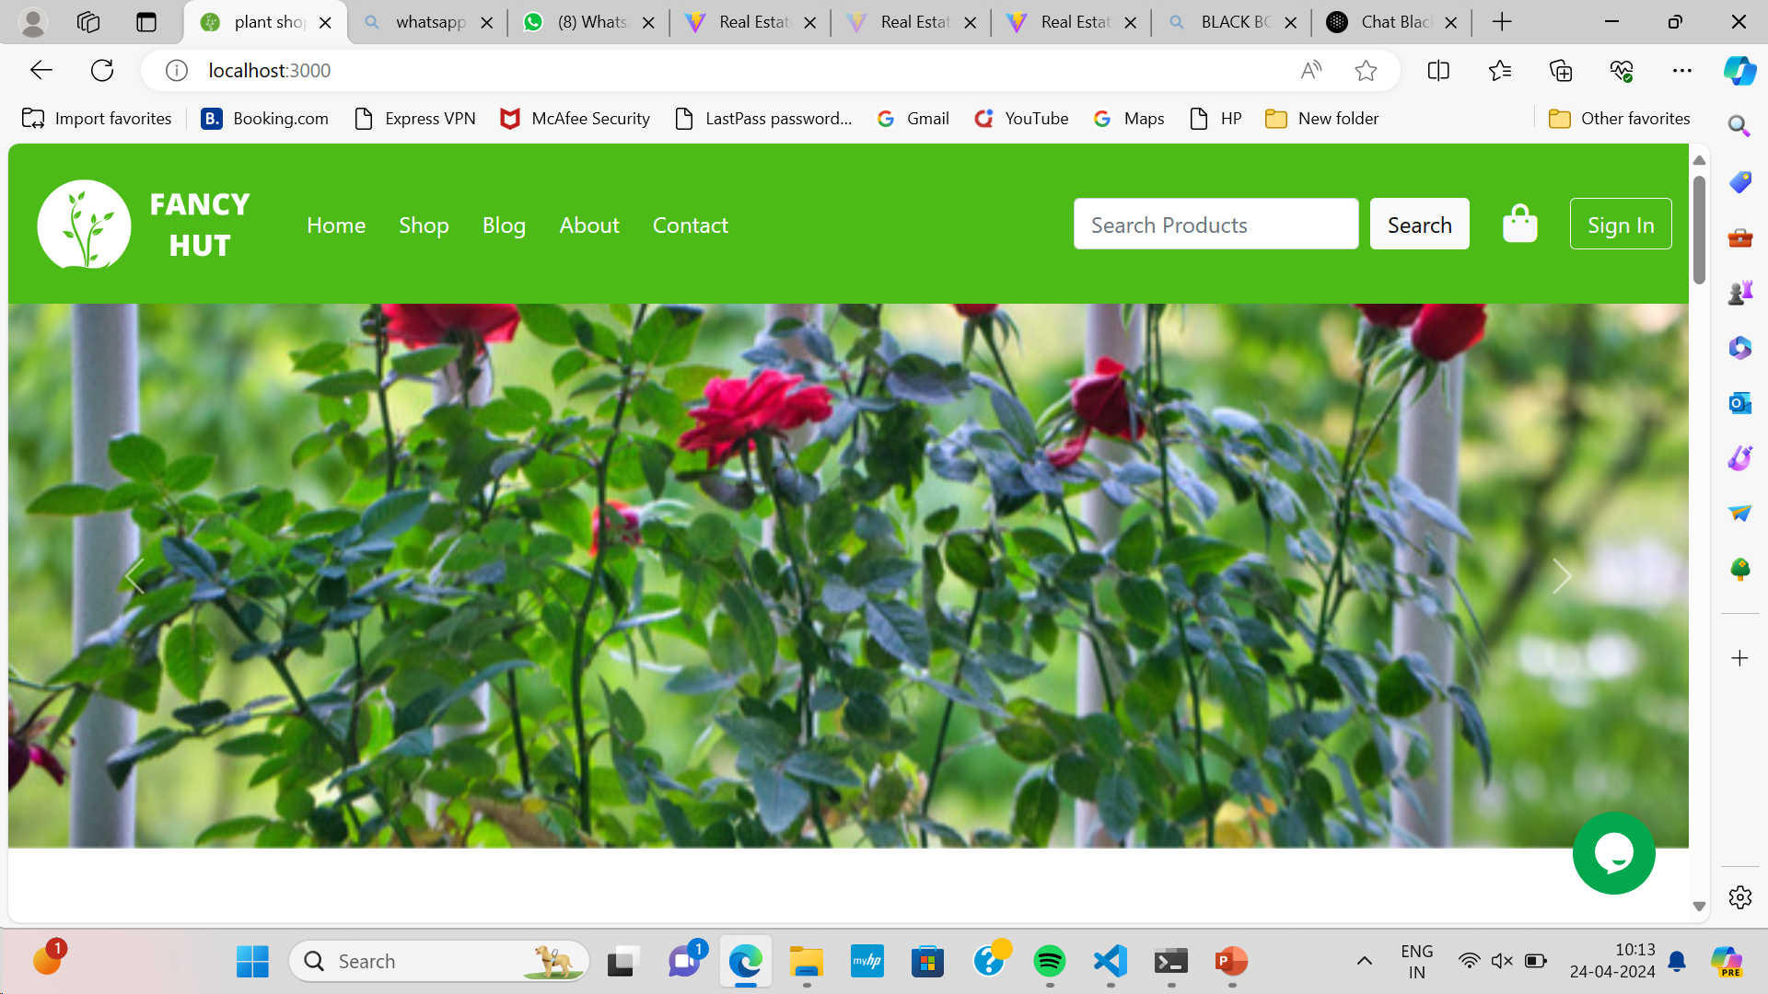
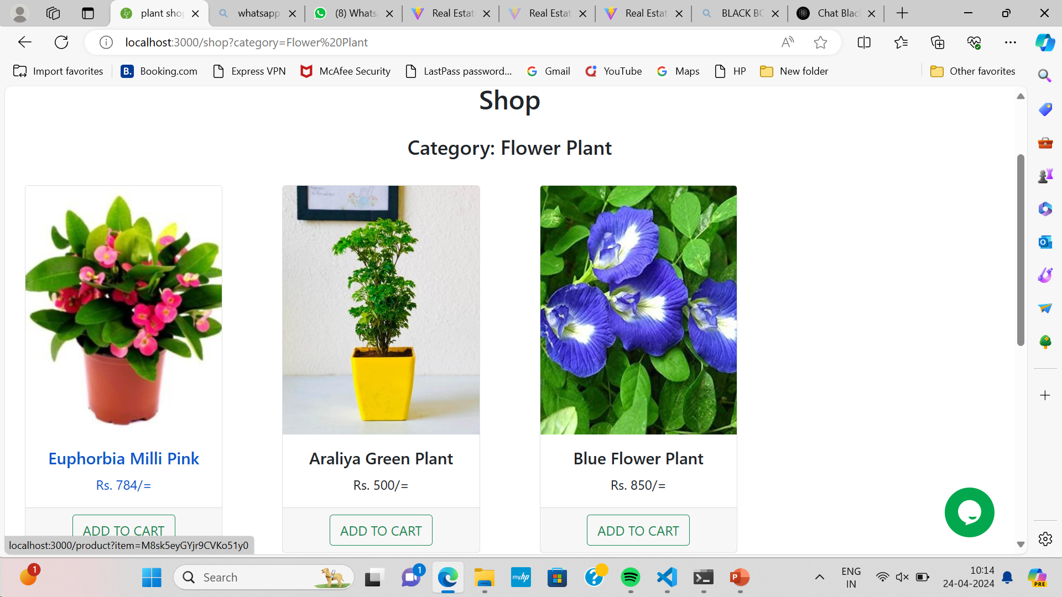
Frontend Output Screenshots

Slide 18
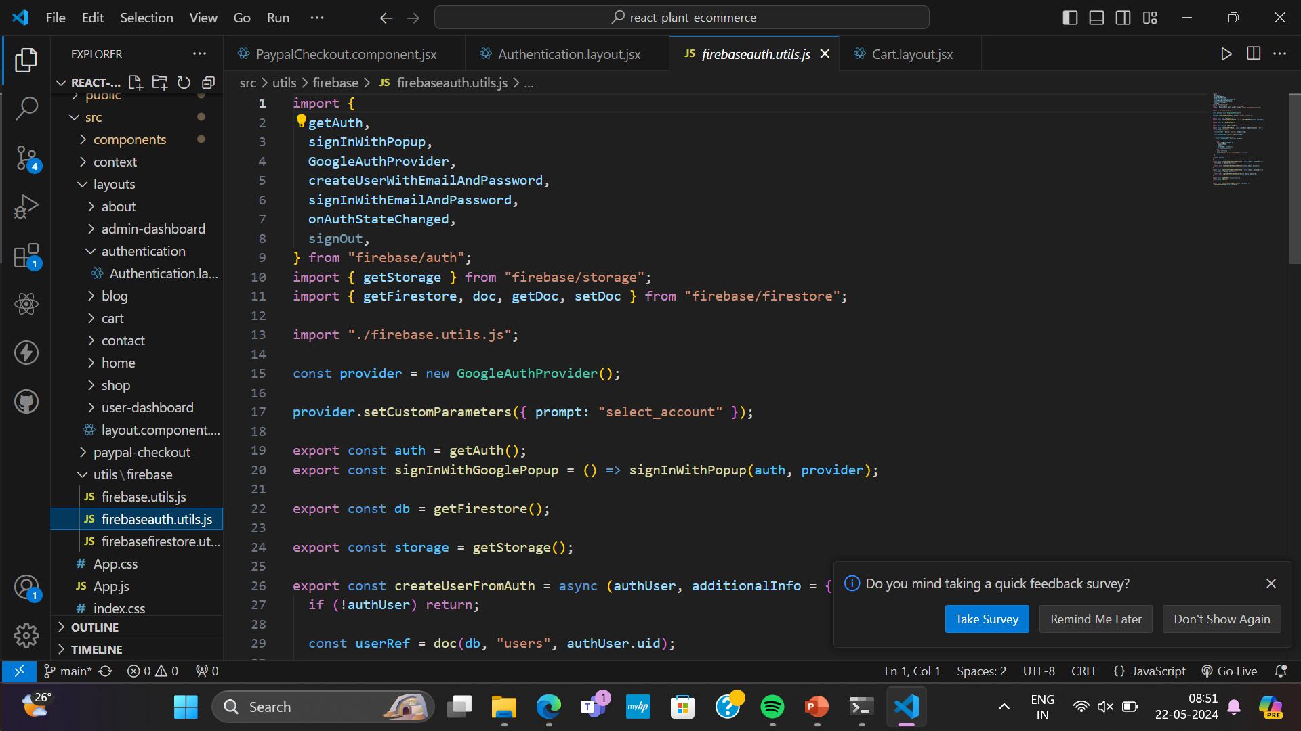
Backend Code Screenshot

Slide 19
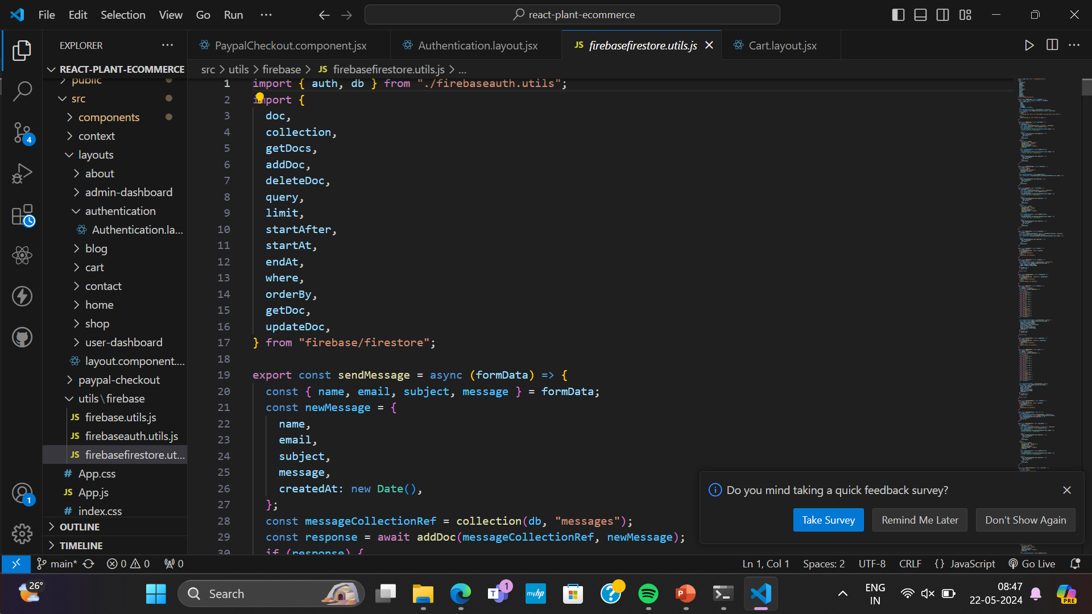
Database Connectivity Screenshot

Slide 20


